Slide 1

Revenue Recognition Part 1 - Video

Slide 2
In This Video
Why revenue recognition?
Dollar Tree vs. Apple
Overview of the 5 steps
First two steps in detail
Notes:
We spend two classes on revenue recognition.
Previously intuition on when to recognize is when it is earned – when you do the work.
This intuition will continue – the problem is that companies enter into all sorts of different contracts that make identifying when and how much revenue to recognize difficult.
Why:
Big impact (incentive) – increasing revenue by 10% will increase profits more than decreasing costs by 10% (usually)
Gray area (ability)
Implications:
-Fraud allegations (AAERS): 366 out of 895 related to revenue recog: 41% (per DGLS)
-Restatements: 25% relate to revenue (GAO from 2002-2005)
4) New standard for firm years beginning after 2018 – in the works for 10+ years. Signed off in 2015

Slide 3

Why revenue recognition?

Slide 4
In a nutshell
Recognize revenue when it is earned.

Slide 5
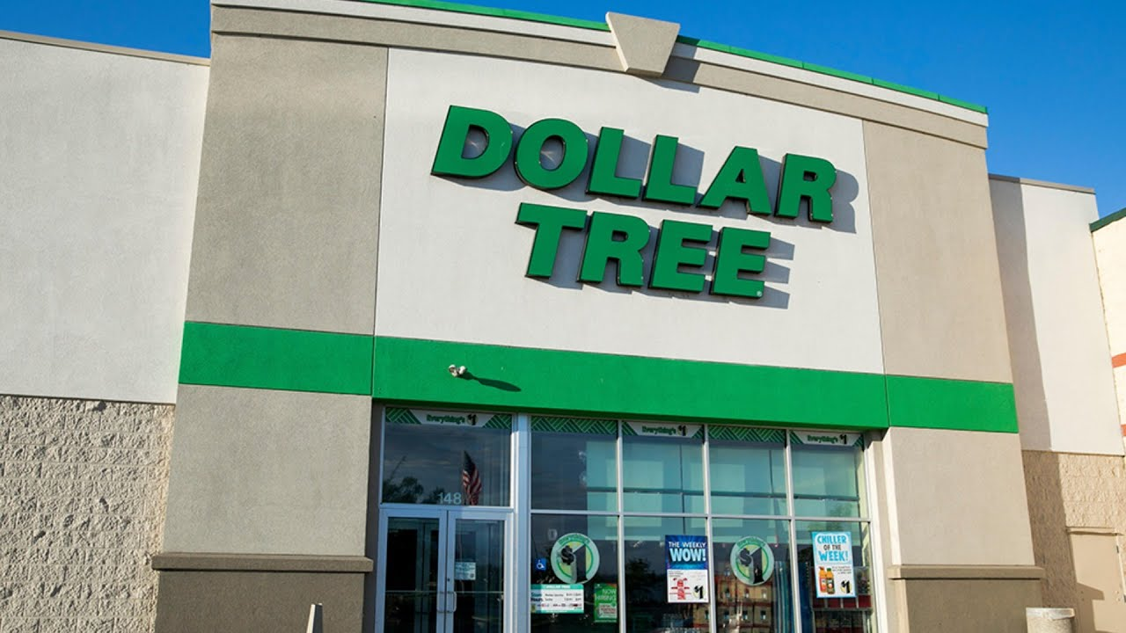
Dollar Tree
Notes:
Simplest policy.
No sales on account, no warranties for future coverage.

Slide 6
Dollar Tree
“Revenue Recognition
The Company recognizes sales revenue at the time a sale is made to its customer.”
- Dollar Tree
Notes:
Simplest policy.
No sales on account, no warranties for future coverage.

Slide 7
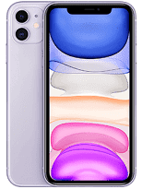
Apple Inc.

Slide 8
Apple Inc. Multiple Deliverables (2007)
“During 2007, the Company began shipping Apple TV and iPhone. For both Apple TV and iPhone, the Company indicated it may provide future unspecified features and additional software products free of charge to customers. Therefore, sales of Apple TV and iPhone handsets are recognized under subscription accounting in accordance with SOP No. 97-2. The Company recognizes the associated revenue and cost of goods sold on a straight-line basis over the currently estimated 24-month economic lives of these products with any loss recognized at the time of sale. Costs incurred by the Company for engineering, sales, marketing and warranty are expensed as incurred.”
- Excerpt from 10-K for the fiscal year ending September 29, 2007
Notes:
This is 2007 b/c interesting rev recog at this time. After we talk about this, I’ll tell you how they recog rev now.
2007:
Defer revenue on iPhone, very unique. Do not defer for iPod. WHY??
They do this b/c of later product updates that are provided free to customer.
They do not defer for ipod b/c they charge for updates.
Why do they want this? Helps smooth sales, less seasonal perhaps.
Now:
Allocate b/w
Hardware/software (recog at sale)
Right to future upgrades in software (straightline 24-48 mos)
Non-software services (straightline 24-48 mos)

Slide 9
Apple Inc. Multiple Deliverables (2019)
“For most of the Company’s Products net sales, control transfers when products are shipped. For the Company’s Services net sales, control transfers over time as services are delivered.
For arrangements with multiple performance obligations, which represent promises within an arrangement that are capable of being distinct, the Company allocates revenue to all distinct performance obligations based on their relative stand-alone selling prices (“SSPs”). When available, the Company uses observable prices to determine SSPs. When observable prices are not available, SSPs are established that reflect the Company’s best estimates of what the selling prices of the performance obligations would be if they were sold regularly on a stand-alone basis
- Excerpt from 10-K for the fiscal year ending September, 2019
Notes:
This is 2007 b/c interesting rev recog at this time. After we talk about this, I’ll tell you how they recog rev now.
2007:
Defer revenue on iPhone, very unique.
They do this b/c of later product updates that are provided free to customer.
They do not defer for ipod b/c they charge for updates.
Now:
Allocate b/w
Hardware/software (recog at sale)
Right to future upgrades in software (straightline 24-48 mos)
Non-software services (straightline 24-48 mos)

Slide 10
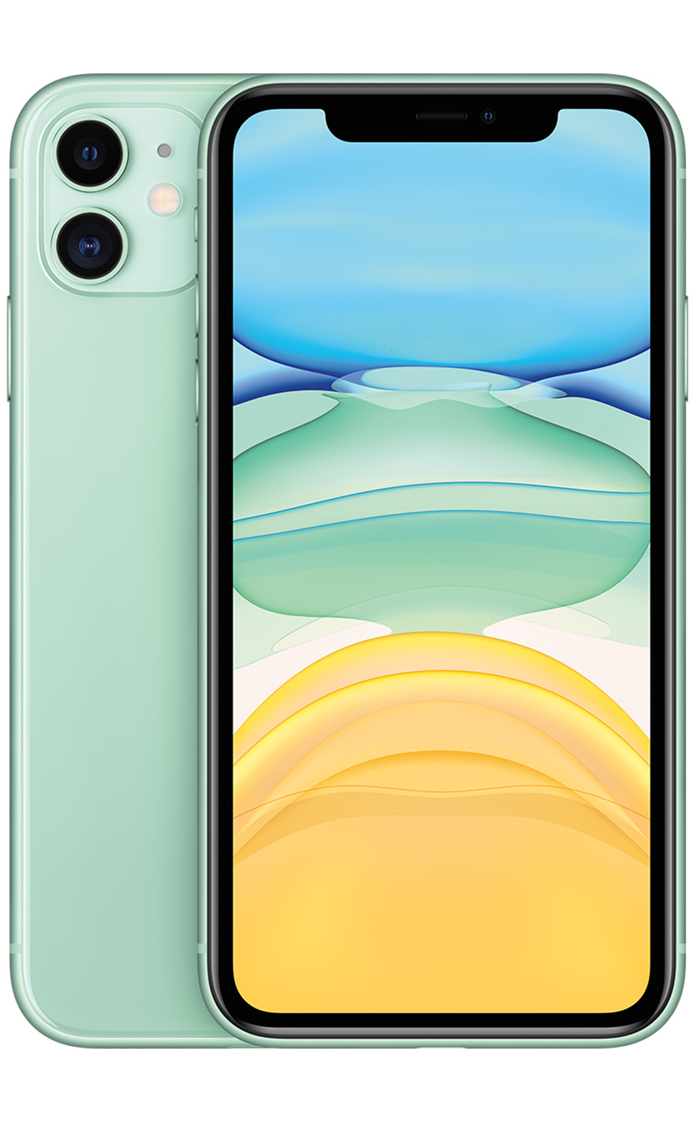
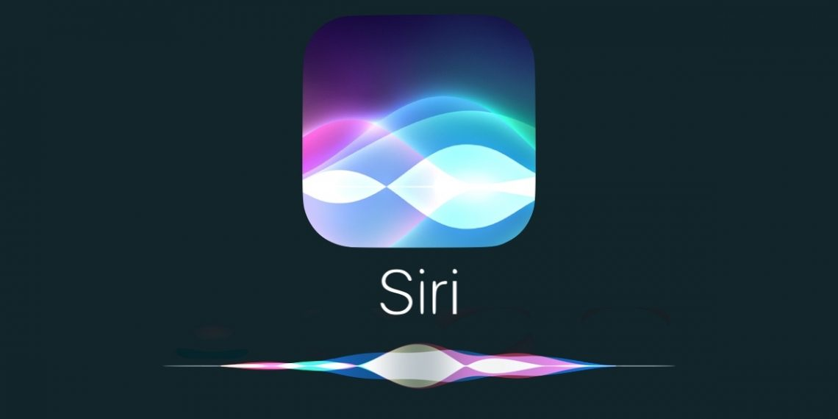
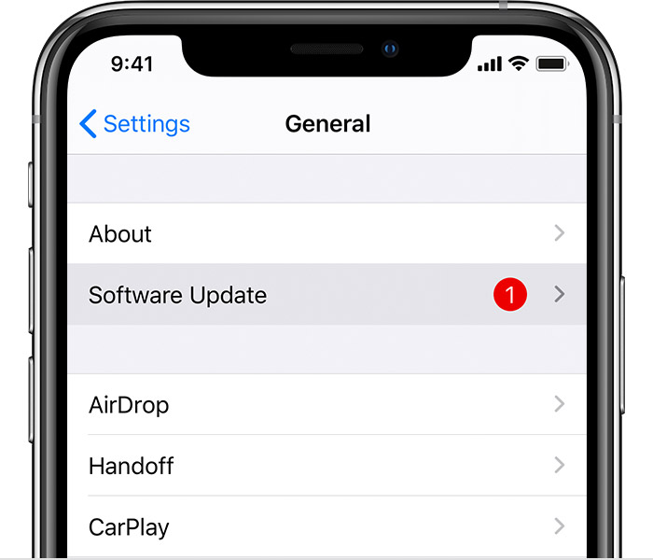
Apple Inc. Multiple Deliverables (2019)
$700 (stand alone)
Upon sale
$200 (estimate)
Over time
$1,000
$100 (estimate)
Over time
Notes:
This is 2007 b/c interesting rev recog at this time. After we talk about this, I’ll tell you how they recog rev now.
2007:
Defer revenue on iPhone, very unique.
They do this b/c of later product updates that are provided free to customer.
They do not defer for ipod b/c they charge for updates.
Now:
Allocate b/w
Hardware/software (recog at sale)
Right to future upgrades in software (straightline 24-48 mos)
Non-software services (straightline 24-48 mos)

Slide 11
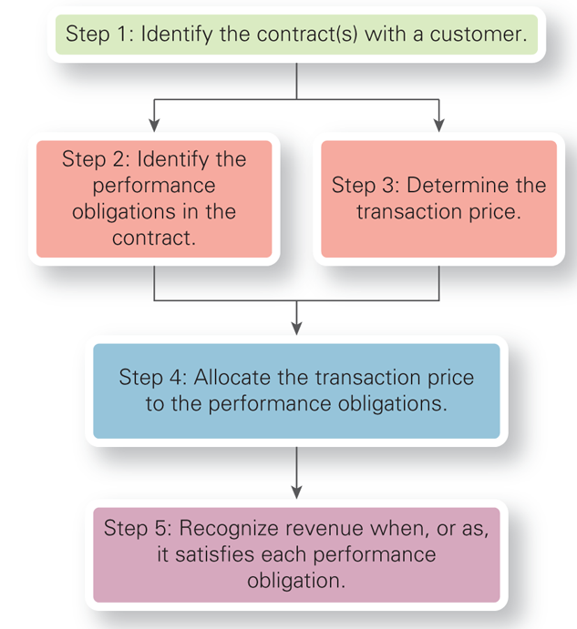
ASC 606: Five Steps to Recognition
Notes:
Contract – usually straightforward, customers wants to buy your goods or services – can’t just ship somebody something!
What do we have to do to earn it? Think Apple – Deliver a phone, deliver software updates
Price – Various complications if the price depends on future actions (returns, sales discounts, volume discounts)
Multiple deliverables – Think Apple – only one price for phone and software
This is when they earn it!

Slide 12
ASC 606: Five Steps to Recognition

Slide 13
ASC 606: Five Steps to Recognition

Slide 14
ASC 606: Five Steps to Recognition

Slide 15
Five Steps for Dollar Tree
Step # | Application
#1: Identify Contract | Customer in the checkout lane with a product
#2: Identify performance obligations | Give product to customer
#3: Determine price | One dollar
#4: Allocate price to performance obligations | Full price ($1) is allocated to giving the product to the customer
#5: Recognize when performance is fulfilled | Customer completes transaction, takes product, then recognize revenue

Slide 16
Step 1: Identify the contract
A contract is an agreement between parties that creates enforceable rights and obligations. Can be written, oral, or implied by normal business practices.

Slide 17
Step 1: Identify the contract
JC Enterprises manufactures designer cases for cell phones and is attempting to enter a new market. To implement this strategy, JC agrees to sell 5,000 units to a retailer for a price of $75 each. The retailer agrees to pay 90 days after delivery. JC knows the retailer is struggling financially, but wants to enter the new market. JC believes they will need to offer the customer a 20% price reduction.
Is this a valid contract?

Slide 18
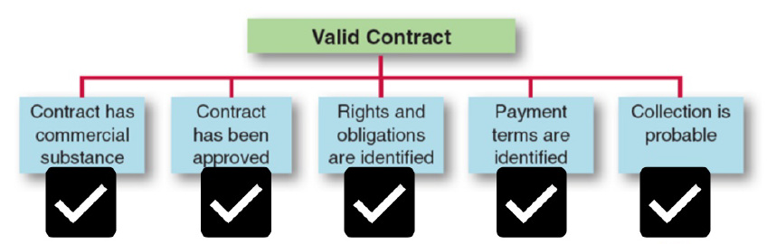
Step 1: Identify the contract
JC Enterprises manufactures designer cases for cell phones and is attempting to enter a new market. To implement this strategy, JC agrees to sell 5,000 units to a retailer for a price of $75 each. The retailer agrees to pay 90 days after delivery. JC knows the retailer is struggling financially, but wants to enter the new market. JC believes they will need to offer the customer a 20% price reduction.
Is this a valid contract?

Slide 19
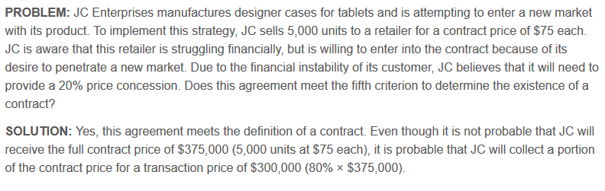
Step 1: Identify the contract
Is this a valid contract?

Slide 20
Step 1: Identify the contract
Is this a valid contract?
Recognize collectible amount

Slide 21
Five Steps to Recognition
Notes:
Contract – usually straightforward, customers wants to buy your goods or services – can’t just ship somebody something!
What do we have to do to earn it? Think Apple – Deliver a phone, deliver software updates
Price – Various complications if the price depends on future actions (returns, sales discounts, volume discounts)
Multiple deliverables – Think Apple – only one price for phone and software
This is when they earn it!

Slide 22
Step 2: Identify performance obligations
A performance obligation is a promise to transfer a distinct good/service to a customer

Slide 23
Step 2: Identify performance obligations
A performance obligation is a promise to transfer a distinct good/service to a customer
Identify goods or services in the contract

Slide 24
Step 2: Identify performance obligations
A performance obligation is a promise to transfer a distinct good/service to a customer
Identify goods or services in the contract
Determine which are “distinct.”

Slide 25
Step 2: Identify performance obligations
A performance obligation is a promise to transfer a distinct good/service to a customer
Identify goods or services in the contract
Determine which are “distinct.”
Customer can benefit from good/service alone or together with other readily available resources to the customer

Slide 26
Step 2: Identify performance obligations
A performance obligation is a promise to transfer a distinct good/service to a customer
Identify goods or services in the contract
Determine which are “distinct.”
Customer can benefit from good/service alone or together with other readily available resources to the customer
Good/service is separately identifiable from other promises in the contract

Slide 27
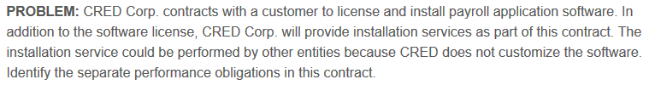
Example: Separate Performance Obligations
Can customer benefit from software alone or in conjunction with other readily available assets?
Are the software and installation separately identifiable?
Notes:
YES, Software license benefit without install b/c not dependent on CRED install (can be done by another firm) -> not interdependent
YES, Install does not modify software and could be performed by another firm.
-> separate performance obligations, identify separately.

Slide 28
Example: Separate Performance Obligations
Can customer benefit from software alone or in conjunction with other readily available assets?
Are the software and installation separately identifiable?
Yes

Slide 29
Example: Separate Performance Obligations
Can customer benefit from software alone or in conjunction with other readily available assets?
Are the software and installation separately identifiable?
Yes
Yes

Slide 30
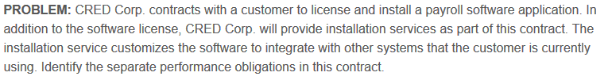
Example: Separate Performance Obligations
Can customer benefit from software alone or in conjunction with other readily available assets?
Are the software and installation separately identifiable?
Notes:
2. NO, b/c install with modify software they are interdependent and can’t be separately identifiable.
-> One performance obligation that should be combined

Slide 31
Example: Separate Performance Obligations
Can customer benefit from software alone or in conjunction with other readily available assets?
Are the software and installation separately identifiable?
No

Slide 32
Example: Separate Performance Obligations
Can customer benefit from software alone or in conjunction with other readily available assets?
Are the software and installation separately identifiable?
No
No

Slide 33
Recap
Goal: Recognize revenue when you provide the good or service
First two steps of revenue recognition
#1 Contract
#2 Performance obligations (everything you provide to the customer)

Slide 34
Revenue Recognition Part 1 - Video

